Slide 1
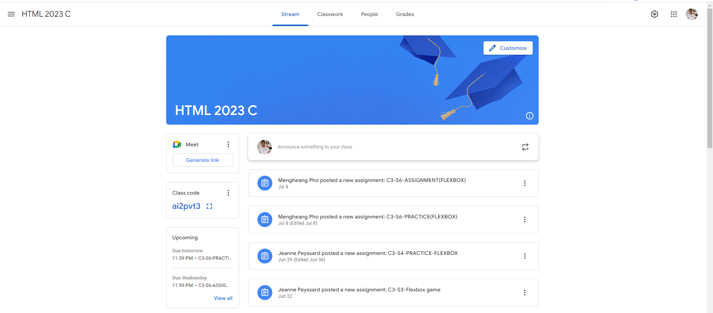
Identify root components of website below

Slide 2
.Root div{ height: 100vh; } | Sets the height of the root div to 100% of the viewport height (100vh stands for 100% of the viewport height). This ensures the container spans the full height of the browser window.
.container { display: flex; height: 100vh; } | The .container class uses flexbox layout (display: flex) to arrange its child elements in a flexible way. It also has a height of 100% of the viewport height, making it fill the entire browser window vertically.
.sidebar { flex: 0 0 200px; background-color: #f0f0f0; } .main-content | - The flex: 0 0 200px property sets the flex-grow, flex-shrink, and flex-basis properties. - - - flex-basis: 200px sets a fixed width of 200px for the sidebar. - The background-color property sets the background color of the sidebar.
.main-content{ flex: 1; background-color: #eOeDe0; } | The flex: 1 property sets the flex-grow property to 1. - The background-color property sets the background color of the main content area.
.Root div{ height: 100vh; } .container { display: flex; height: 100vh; } .sidebar { flex: 0 0 200px; background-color: #f0f0f0; } .main-content{ flex: 1; background-color: #eOeDe0; }

Slide 3
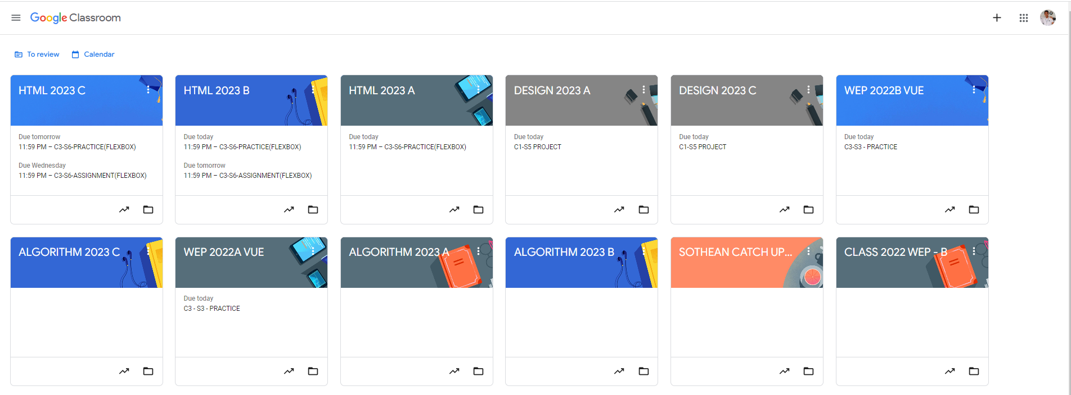
Root div
- Height: 100vh
content
nav
Flex: 0
header
Flex: 0
Flex: 1

Slide 4
.page-container { display: flex; flex-direction: column; height: 100vh; } | The main container sets a vertical layout for the entire page, ensuring that the height covers the viewport.
. top-nav { display: flex; justify-content: space-between; align-items: center; padding: 0 20px; background-color:#fff; } | Aligns navigation items horizontally with space between them. justify-content: space-between is used to spread them out, and align-items: center centers them vertically.
.nav-items{ display: flex; gap:15px； ｝ | Uses Flexbox to align items horizontally with a gap between each item for spacing.
.main-container { display: flex; flex-direction: column; flex-grow: 1; ｝ | Stacks the main content vertically. flex-grow: 1 ensures it takes up available space, and overflow-y: auto handles scrolling.
. header-section{ display: flex; justify-content: space-between; align-items: center; padding: 10px 20px; Background-color: #fofofo; } | Aligns the header content (like the class title and buttons) evenly with padding for spacing.

